Slide 1
Debug in Visual Studio

Slide 2

Before start
Familiar in Visual Studio
Understand conditional statements
Understand loop statements

Slide 3
Lesson Objectives
Debug in Visual Studio
Debug Mode vs Release Mode
#if DEBUG tag
StackTrace
Remote debug

Slide 4
Debug in Visual Studio
Section 1

Slide 5
Debugging
Debugging means to run your code step by step in a debugging tool like Visual Studio, to find the exact point where you made a programming mistake. You then understand what corrections you need to make in your code, and debugging tools often allow you to make temporary changes so you can continue running the program.

Slide 6
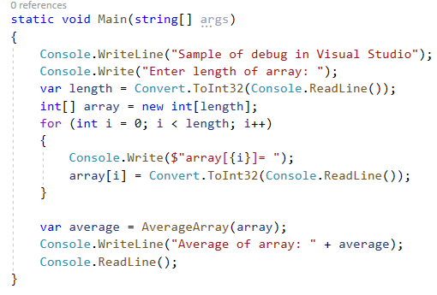
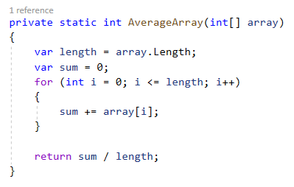
Use code sample

Slide 7
Clarify the problem
Before start debugging, make sure you've identified the problem you're trying to solve:
What did you expect your code to do?
What happened instead?

Slide 8
Examine your assumptions
Ask yourself to challenge your assumptions:
Does your code contain any typos?
Did you make a change to your code and assume it is unrelated to the problem that you're seeing?
Did you expect an object or variable to contain a certain value (or a certain type of value) that's different from what really happened?
Do you know the intent of the code?

Slide 9
Examine your assumptions
Check the common error:
Divide by zero
Invalid operation
Index out of range (array)
Wrong format
Null reference
Clean your code
Update code following coding conventions

Slide 10
Debugging mode
Running an app within a debugger, also called debugging mode, means that the debugger actively monitors everything that’s happening as the program runs.
It also allows you to pause the app at any point to examine its state, and to then step through your code line by line to watch every detail as it happens.

Slide 11
Debugging mode
Note: If your solution has multi-projects, set project as StartUp Project
To start debugging mode
Press F5
From menu, select Debug > Start Debugging
Right click on the project, choose Debug > Start new instance

Slide 12
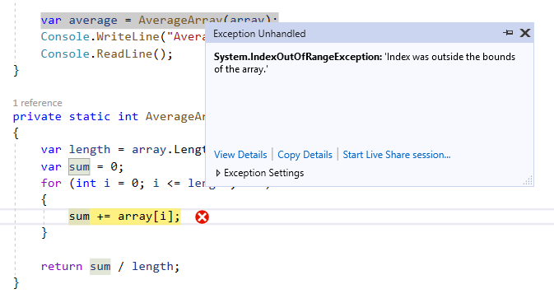
Debugging mode

Slide 13
Breakpoints
Breakpoints are the most basic and essential feature of reliable debugging.
A breakpoint indicates where Visual Studio should suspend your running code so you can take a look at the values of variables, or the behaviour of memory, or whether or not a branch of code is getting run.

Slide 14
Breakpoints
To set breakpoints:
Clicking in the margin to the left of a line of code to set breakpoint(s)
Focus your cursor in line of code then press F9
Focus your cursor in line of code, then from menu, select Debug > Toggle Breakpoint
Right-click and select Breakpoint > Insert breakpoint.
To remove breakpoints:
Do the same one more time
Delete all breakpoints: from menu Debug > Delete all breakpoints or Ctrl + Shift + F9

Slide 15
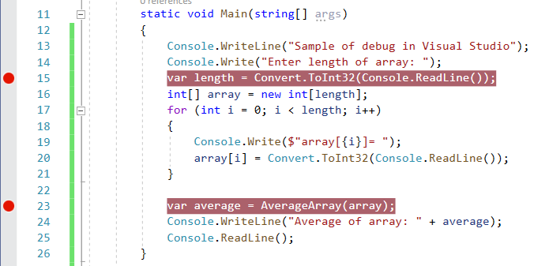
Breakpoints
The breakpoint appears as a red dot in the left margin and current execution lines are automatically highlighted

Slide 16
Breakpoints
The breakpoint appears as a red dot in the left margin and current execution lines are automatically highlighted

Slide 17
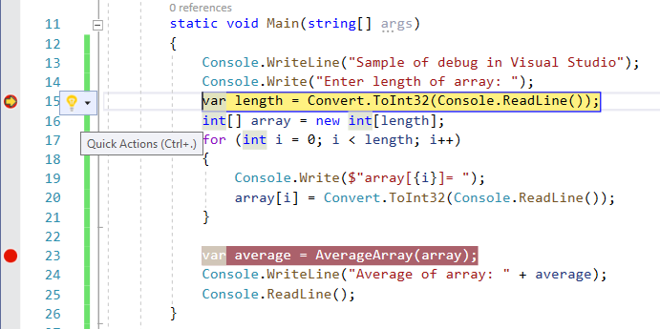
Breakpoints
When you debug, execution pauses at the breakpoint, before the code on that line is executed. The breakpoint symbol shows a yellow arrow.

Slide 18
Navigate code in the debugger
F11 (Step Into)
examine the execution flow
F10 (Step Over)
skip over code that you're not interested in
Shift + F11 (Step Out)
resumes app execution (and advances the debugger) until the current function returns.
Ctrl + F10 (Run to Cursor)
quickly set a temporary breakpoint and execute app to the breakpoint

Slide 19
Inspect data
Inspect data is most important features of the debugger
Inspect data:
Hover over an object with the mouse and you see its data
Right click then select Add Watch
Right click then select Quick Watch

Slide 20
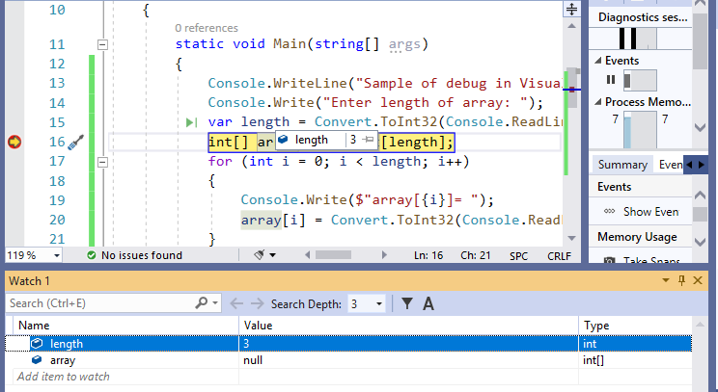
Inspect data

Slide 21
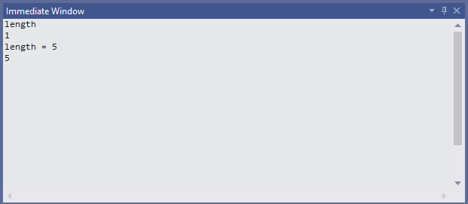
Immediate window
The Immediate window evaluates expressions by building and using the currently selected project.
evaluate expressions,
execute statements,
print variable values.

Slide 22
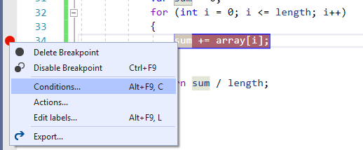
Breakpoint conditions
Used to control when and where a breakpoint executes.
The condition can be any valid expression that the debugger recognizes.

Slide 23
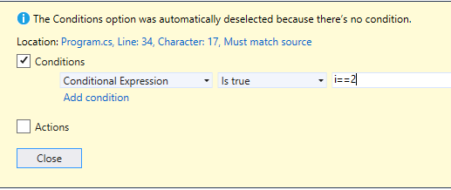
Breakpoint conditions
Conditional Expression
Hit Count
Filter

Slide 24
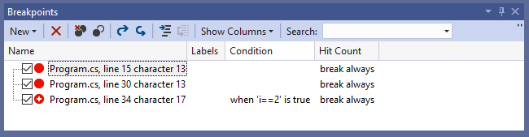
Breakpoints window
In the Breakpoints window, you can search, sort, filter, enable/disable, or delete breakpoints.
You can also set conditions and actions, or add a new function or data breakpoint.

Slide 25
Debug and release configurations
Section 3

Slide 26
Debug and release configurations
In debug configuration, your program compiles with full symbolic debug information and no optimization. Optimization complicates debugging, because the relationship between source code and generated instructions is more complex.
The release configuration of your program has no symbolic debug information and is fully optimized.
You can change build configuration in Configuration Manager or from toolbar

Slide 27
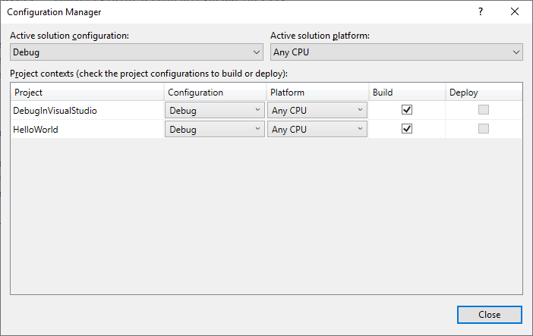
Debug and release configurations

Slide 28
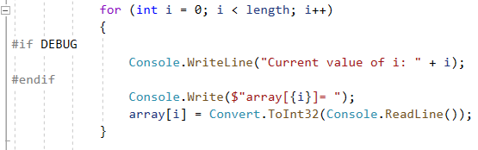
#if DEBUG tag
#if DEBUG:
///The code in here won't even reach the IL on release.
#endif

Slide 29
Edit code and continue
Edit and Continue is a time-saving feature that enables you to make changes to your source code while your program is in break mode.
When you resume execution of the program by choosing an execution command like Continue or Step, Edit and Continue automatically applies the code changes with some limitations.
This allows you to make changes to your code during a debugging session, instead of having to stop, recompile your entire program, and restart the debugging session.

Slide 30
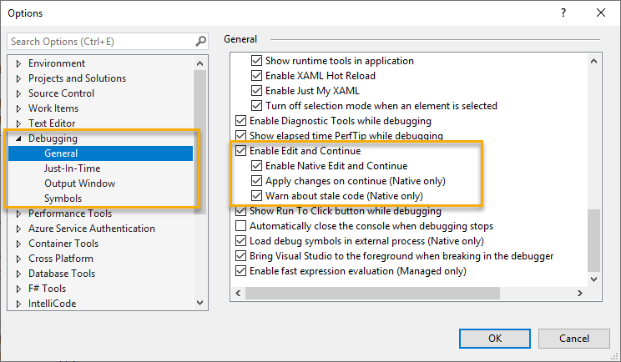
Edit code and continue

Slide 31
Remote Debugging
Section 4

Slide 32
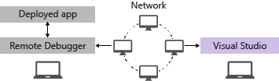
Remote Debugging
To debug a Visual Studio application that has been deployed on a different computer, install and run the remote tools on the computer where you deployed your app, configure your project to connect to the remote computer from Visual Studio, and then run your app.

Slide 33
Remote Debugging
Download and Install the remote tools
Set up the remote debugger
Account to run
Port
Debug package on server

Slide 34
Remote Debugging
Step 1: Attach process
Step 2: enter Connection target (include address and port)
Step 3: enter credential
Step 4: connect and debug

Slide 35
Lesson Summary

Slide 36

Thank you

